Slide 1
Amazon Sales Analysis
Name : M Janaki Ramudu

Slide 2
Introduction
Problem Statement: Sales management has gained importance to meet increasing competition and the need for improved methods of distribution to reduce cost and to increase profits. Sales management today is the most important function in a commercial and business enterprise.
Tools Used: Power Query and Power BI

Slide 3
Data Preparation
Data Transformation & Cleaning
Removing null values
Correcting data types
Adding necessary measures and columns

Slide 4
Visualization Creation
Visualization Process
Loading data into Power BI
Creating various visualizations

Slide 5
Key Visualizations
Map of Total Revenue by Country
Sum of Total Revenue, Profit, and Cost by Item Type
Average Duration to Deliver Priority Wise
Sum of Total Revenue, Profit, and Cost by Year
Sum of Total Revenue by Country
Slicers for Region and Sales Channel
Date Range Selector
KPIs (Key Performance Indicators)

Slide 6
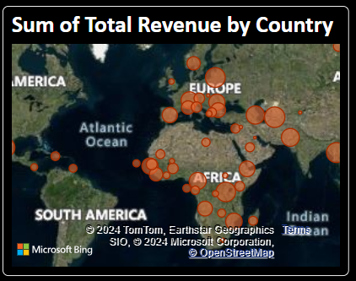
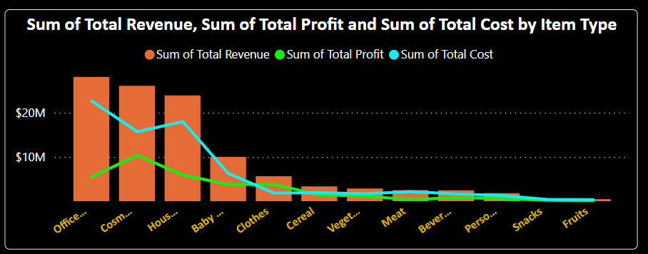
Visualization Details
Map of Total Revenue by Country
Shows revenue distribution globally.
Sum of Total Revenue, Profit, and Cost by Item Type
Highlights top-performing product categories.

Slide 7
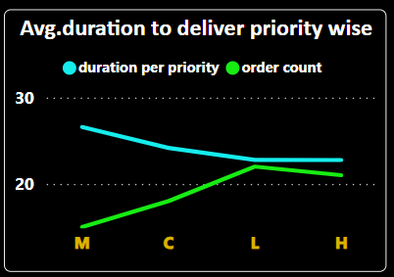
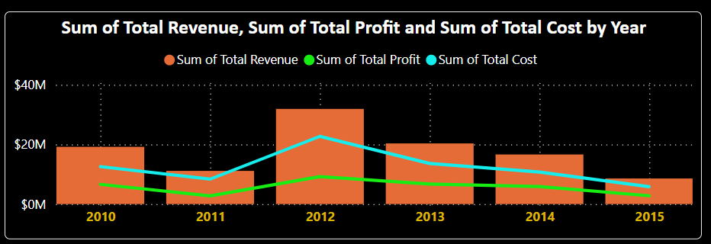
Average Duration to Deliver Priority Wise
Displays average delivery duration and order count across priorities.
Sum of Total Revenue, Profit, and Cost by Year
Tracks financial trends over the years.

Slide 8
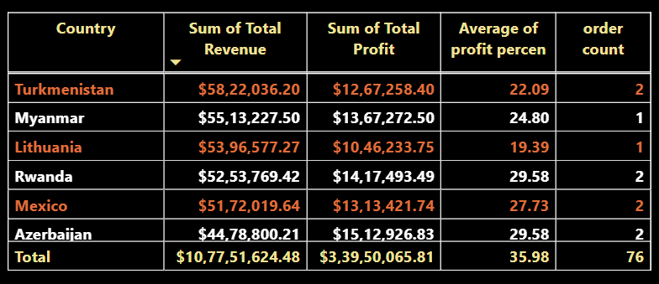
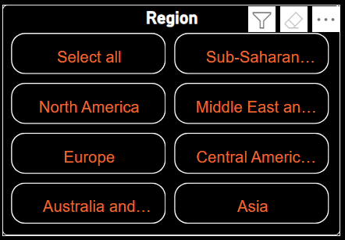

Sum of Total Revenue by Country
Lists countries with the highest revenue.
Slicers for Region and Sales Channel
Interactive filters for region and sales channel.

Slide 9
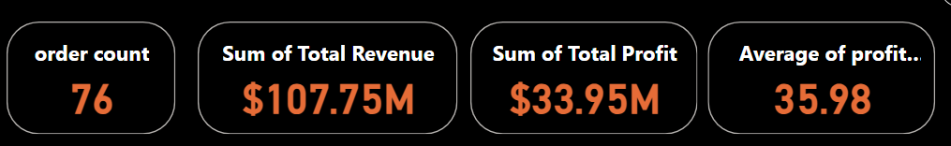
KPIs (Key Performance Indicators)
Displays key metrics such as total order count, total revenue, total profit, average profit percentage, and sum of units sold.

Slide 10
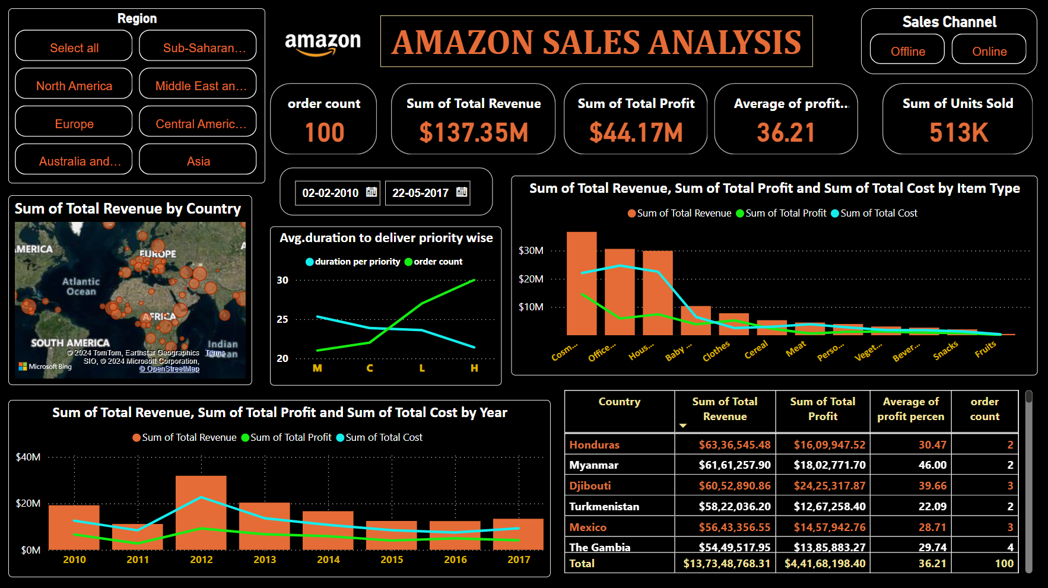

Slide 11
Key Insights
The Gambia has the most orders.
Djibouti records the highest total profit of $24,25,317.
Honduras achieves the highest total revenue of $63M, followed by Myanmar with $61M.
Cosmetics generate the highest revenue at $366K, with the highest profit margin.
High Priority orders have the shortest delivery duration and highest profit percentage.
In 2012, the highest number of orders were placed (22), followed by 2013 with 12 orders.
Sub-Saharan Africa is the leading region with 36 orders.
Sales channels analysis shows an equal split between online and offline orders, but the online mode yields higher profit percentages despite fewer units sold.
Sub-Saharan Africa and Europe are significant contributors to total revenue.
Office supplies and household items are major contributors to total revenue.
Middle East and Central America regions have higher average profit percentages.
Offline sales channel has more units sold but lower average profit percentage compared to online.

Slide 12
Skills Enhanced:
Power Query features and formulas.
Power BI visualizations and interactivity.
PowerBI file link : https://drive.google.com/file/d/16jtEHdv9MV8zCl1nyTj0AR01Ssf9aLAx/view?usp=sharing

Slide 13
Thank You

